Slide 1
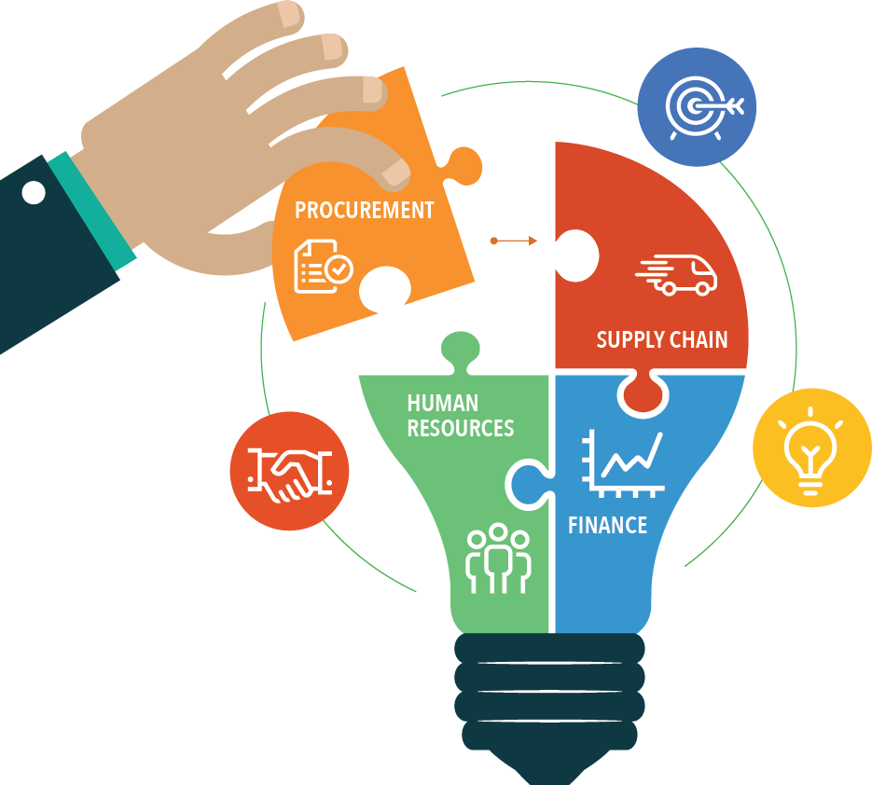

THE ERP DECISION
OPIM 5604: Business Decision Modeling – Final Project
Presented By: Group 6
SHALOMA GHOSH
INDRAJIT BHATTACHARYA
KRITI GUPTA
JAYASREE AKULA
RIKDEV BHATTACHARYA

Slide 2

AGENDA
Business Scenario
Problem Description
Key Parameters and Variables
Business Insights and Analysis
Recommendations
Questions and Answers

Slide 3



BUSINESS SCENARIO
Leading Manufacturing Company
Offices all across the world
Annual Revenue over $ 5 Million
Decentralized Procurement
High Cost of Maintaining Old Systems
High Variable Cost %
Unable to Scale
Changing Business Scenario
CIO vs CFO
Decide upon whether to invest in ERP or ERP+CRM or Not
Decision based on Hurdle Rate

Slide 4






PROBLEM DESCRIPTION
FINANCIAL PARAMETERS
MANPOWER RELATED PARAMETERS
PROFIT
NET PRESENT VALUE
RETURN ON INVESTMENT
20 YEAR TIME FRAME
INVEST IF THE PROJECT RATE OF RETURN > HURDLE RATE
TECHNOLOGY RELATED PARAMETERS

Slide 5

KEY PARAMETERS AND VARIABLES
Initial Investment on ERP : $36,295.00
The business is most sensitive to the changes in the following parameters
Variable Cost %
Rate of Growth in Revenue
Inflation %
Initial Investment Quantum
Manpower Cost
Cost of Maintaining Old Systems
Hardware Cost $ 6,000 spread over 2 Years
Software Cost $ 11,000 spread over 2 Years
Manpower Cost $ 19,295 spread over 7 Years
Initial Investment on ERP and CRM : $39,362.63
Hardware Cost $ 7,000 spread over 5 Years
Software Cost $ 12,000 spread over 5 Years
Manpower Cost $ 20,362 spread over 7 Years
Holding Rate and Average Inventory turnover does not have a significant effect on the profit
With a 8% increase in investment in ERP and CRM, the business can expect to generate 60% more revenues than only from an investment in ERP

Slide 6
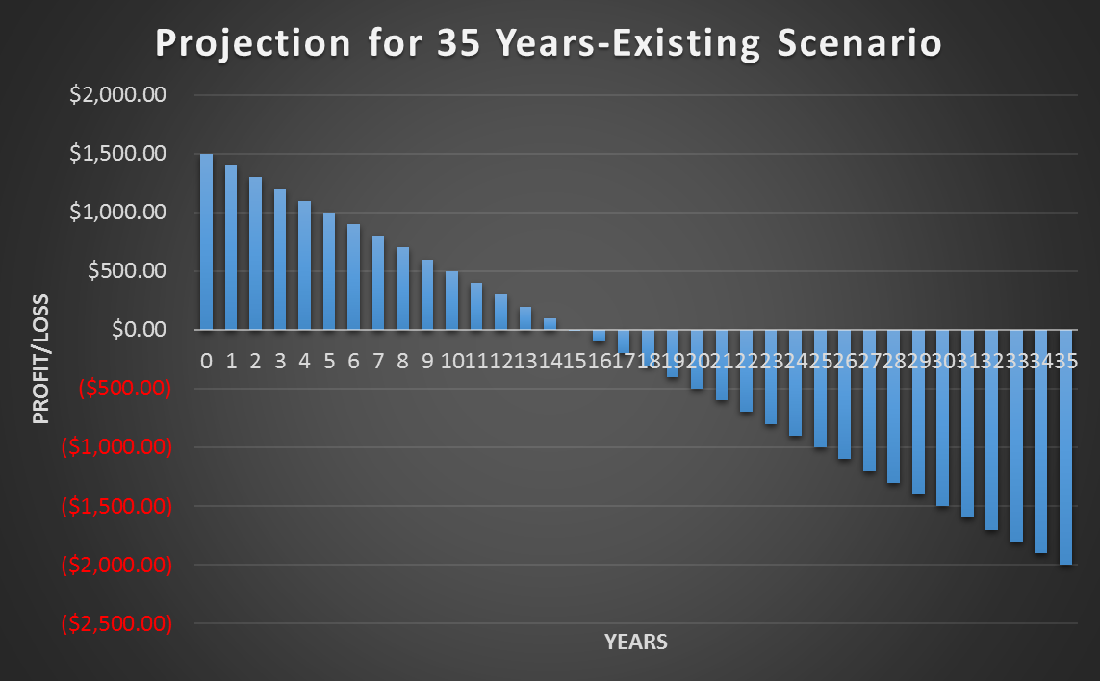
BUSINESS INSIGHTS AND ANALYSIS
The business will increasingly become unprofitable primarily because of Yearly Cost of maintaining old systems.
Given the current scenario the company is expected to run into losses from the 16th Year in operation if they do not switch over to ERP or CRM systems

Slide 7
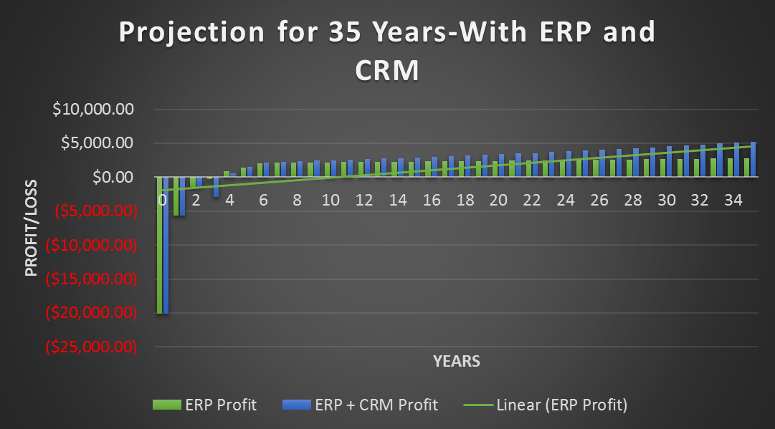
BUSINESS INSIGHTS AND ANALYSIS
The company is expected to suffer huge losses for the first four years after its implementation of ERP and ERP with CRM
For a 35-year period, the business with the ERP & CRM Implementations will increasingly become more profitable

Slide 8
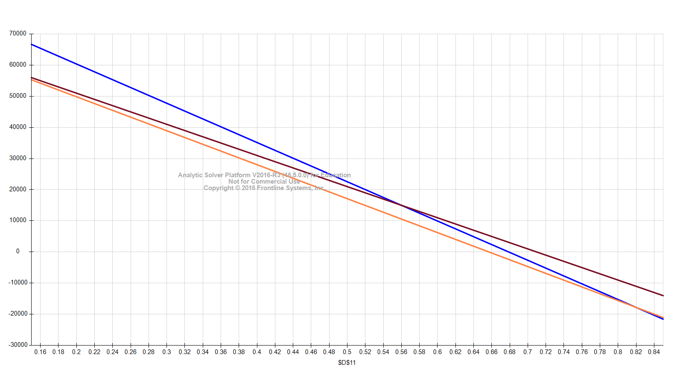
BUSINESS INSIGHTS AND ANALYSIS
Variable Cost % Sensitivity with Profits from Existing, ERP and ERP + CRM Scenario
Variable Cost % has the most significant effect on the profit, ROI and NPV outcomes
Variable Cost % should not cross the 65% mark; this will result in definite losses for the business
Lower the Variable Cost %, higher the Rate of Return for the project

Slide 9
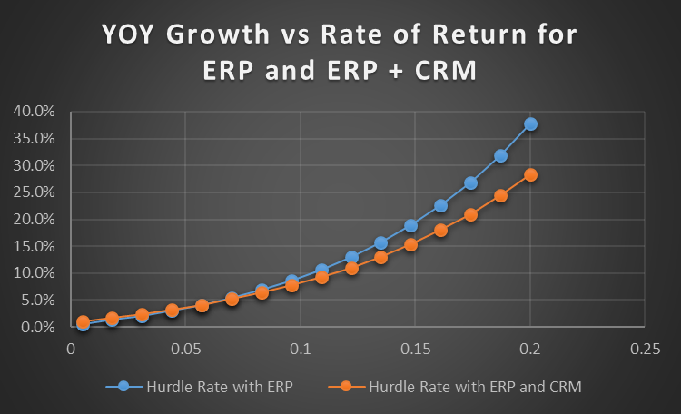
BUSINESS INSIGHTS AND ANALYSIS
With all other factors constant the YOY Growth should be maintained at least at 10% for the project to meet the existing hurdle rate
ERP with CRM is expected to meet the Hurdle Rate at a lower YOY Growth Rate

Slide 10
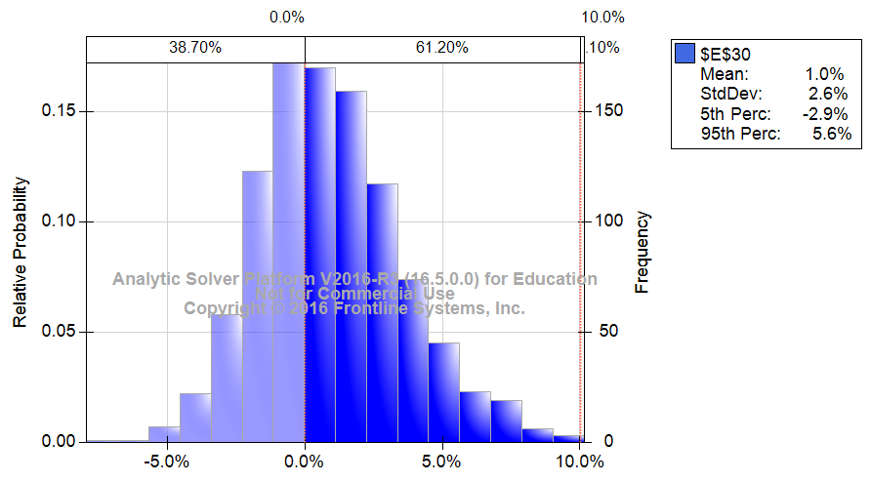
BUSINESS INSIGHTS AND ANALYSIS
Simulation Rate of Return for ERP implementation
There is a 61.2% chance of the rate of return falling between 0-10%
The hurdle rate should be kept at lesser than 10% for this project considering a 35 year projection

Slide 11
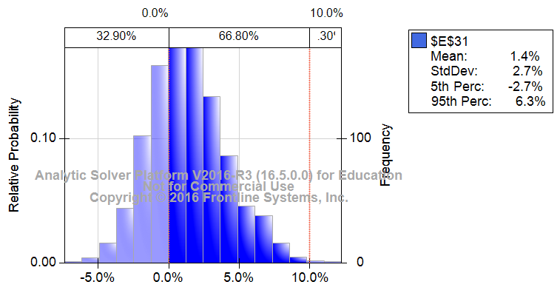
BUSINESS INSIGHTS AND ANALYSIS
Simulation Rate of Return for ERP & CRM implementation
There is a 66.8% chance of the rate of return falling between 0-10%
The hurdle rate should be kept at lesser than 10% for this project considering a 35 year projection

Slide 12
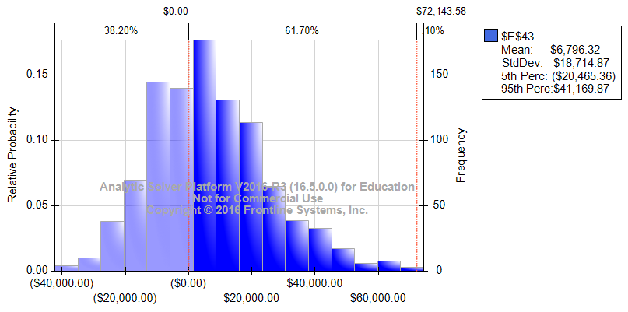
BUSINESS INSIGHTS AND ANALYSIS
Simulation NPV for ERP implementation
There is a 61.7% chance of the NPV falling between 0 and $72,143.58
Due to the high chance of a positive NPV, we should go ahead with the investment on the project

Slide 13
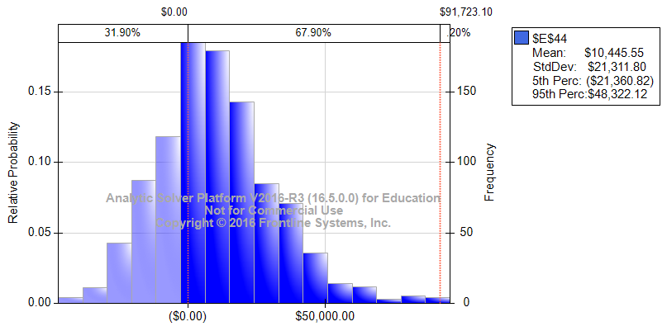
BUSINESS INSIGHTS AND ANALYSIS
Simulation NPV for ERP & CRM implementation
There is a 67.9% chance of the NPV falling between 0 and $91,723.10
Due to the high chance of a positive NPV, we should go ahead with the investment on the project

Slide 14




RECOMMENDATIONS
We recommend investing in the project for both ERP and CRM systems based on a 35-year period
Y-o-Y revenue growth % has the most potent effect on the profits. The company should try to maximize its revenue growth as much as possible
Keeping a 35 year period in mind the company should reduce its hurdle rate
The company should put immense focus on bringing down the variable cost as low as possible.

Slide 15


